Slide 1
Feature tracking as an indication of attention
Collin Edington
Scott Kennedy

Slide 2
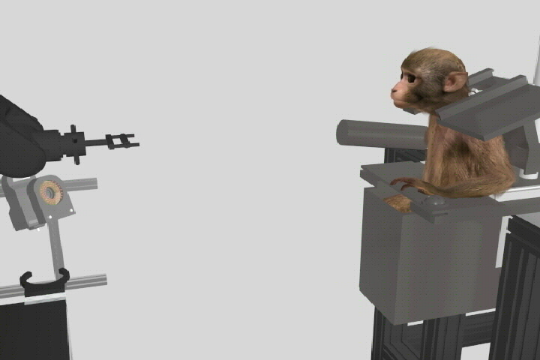
Start
Go
End
Intertrial
ButtonPress
Reach
Intertrial
50 ms
Notes:
I work in a lab that studies the neural control of volitional movement. In order to do this, we must train a monkey to perform a behavioral task while recording relevant experimental data. This video is an example of the grasp task, in which the robot presents an object which the monkey must reach out and grasp. The task is initiated when the monkey presses the start button, sending the start signal, and beginning the ‘Button Press’ time epoch. During this period, the robot moves into position. The go signal occurs when the robot stops moving, beginning the ‘Reach’ epoch. The trial terminates when the monkey successfully grasps the object or exceeds a maximal time, both of which send the end signal. The intertrial epoch is the time between the end of one trial and the start of the next trial.

Slide 3
Statistics
Goals
Total trials
Success rate
Statistics
Successful trials
Unsuccessful trials
Notes:
Before collecting experimental data, two criteria must be reached during the training period: the monkey must attempt a minimum number of total trials, and the monkey must achieve a minimum success rate.
Currently, we record the number of successful trials, when the monkey correctly grasps the object,

Slide 4
Statistics
Goals
Total trials
Success rate
Statistics
Successful trials
Unsuccessful trials
Notes:
And the number of unsuccessful trials, when the monkey reaches for the object, but does not correctly grasp it.

Slide 5
Statistics
Goals
Total trials
Success rate
Statistics
Successful trials
Unsuccessful trials
Null trials
Notes:
However, unsuccessful trials are ambiguous. If the monkey initiates the trial, but stops paying attention in the middle of the trial, he artificially increases his total trials and decreases his success rate. If the monkey is skilled at grasping the object, but is easily distracted, this would not be reflected in the statistics we currently track. As a result, I may erroneously assume I should spend time teaching him how to grasp the object, while in fact, I should work on ways to make him more attentive. Therefore, the goal of this project is to record a third statistic, null trials, and thereby improve the training process.

Slide 6
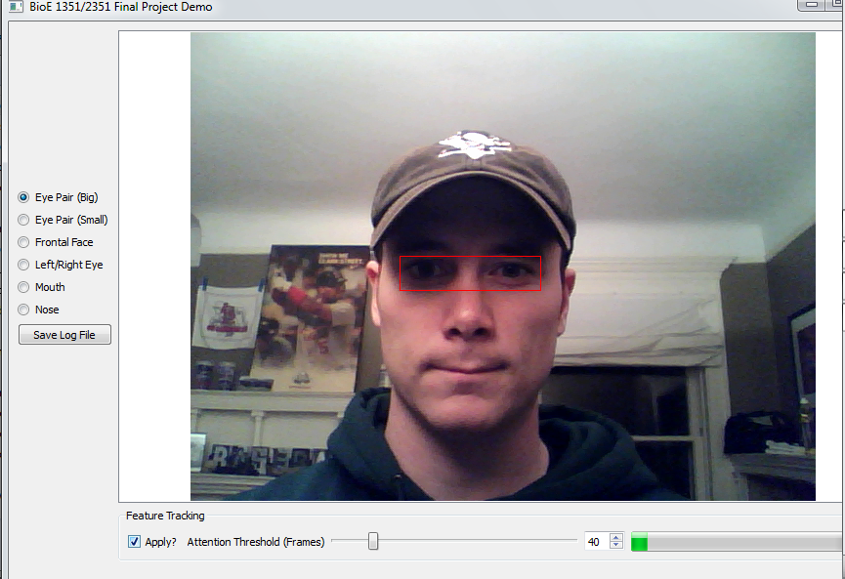
Positive: 13
Negative: 8
Percentage: 61.90
Notes:
Our feature tracking program provides the ability to record how often the monkey is facing forward and make an assumption about his attention. The GUI allows different features to be tracked, the current feature is the big eye pair, and presents real time statistics. At the completion of every trial, there appears either a green box, indicating a positive trial, that he was paying attention, or a red box, indicating a negative trial, that he was not paying attention. Attention is determine by the percentage of positive frames within a trial, adjustable using the slide or roll box. The total number of positive and negative trials in the session, as well as the percentage, is also displayed. By clicking the Save Log File button, you generate a tab-delimited log file which looks like this.

Slide 7
Time | Trial | Feature | Intertrial | ButtonPress | Reach
0.00 | 1 | 1 | 1 | NaN | NaN
0.03 | 1 | 1 | 1 | NaN | NaN
0.06 | 1 | 1 | 0 | NaN | NaN
0.51 | 1 | 1 | NaN | 0 | NaN
0.54 | 1 | 1 | NaN | 1 | NaN
0.57 | 1 | 1 | NaN | 1 | NaN
1.33 | 1 | 1 | NaN | NaN | 1
1.36 | 1 | 1 | NaN | NaN | 0
1.39 | 1 | 1 | NaN | NaN | 1
2.40 | 2 | 1 | 1 | NaN | NaN
2.43 | 2 | 1 | 1 | NaN | NaN
2.46 | 2 | 1 | 1 | NaN | NaN
Notes:
This allows offline statistical analysis of each frame. Included is the time at which the frame was taken, the current trial, feature, and time epoch. Features are numbered according to the listing on the GUI and the time epoch consists of either a boolean output of feature detection, or a NaN if the time epoch is not current. Using this data we hope to have a more complete representation of monkey performance and improve the efficacy of behavioral training.

